Slide 1
Optimizing Decision Trees and Random Forest Models
Laura Ye
March 15, 2018

Slide 2
Goals
The data is related to direct marketing campaigns (phone calls) of a Portuguese banking institution. The classification goal is to predict if the client will subscribe a term deposit.
Use decision trees and random forest models (with optimization)
Metrics used for comparison:
Accuracy
Area under the ROC curve (AUC)
ROC Plot

Slide 3
About the Data
Telemarketing data set obtained from UC Irvine’s Machine Learning Repository https://archive.ics.uci.edu/ml/datasets/bank+marketing
41188 rows, 21 columns (including response variable)
Explanatory variables include:
Age, job, marital status, education, default, housing, loan, contact, month, day of week, duration, campaign...

Slide 4
Plan – Data Preparation
Load Data
Clean Data
Split Data
Training (70%)
Validation (15%)
Testing (15%)

Slide 5
Plan – Model Tuning and Evaluation
Training (70%)
Train
Decision Tree
Testing (15%)
Train
Random Forest
Evaluate
Decision Tree
Tune
Decision Tree
Ideal Parameters for Decision Tree
Compare and select model
Hyperparameter
Grids
Evaluate
Random Forest
Ideal Parameters for Random Forest
Validation (15%)
Tune
Random Forest

Slide 6
Data Preparation
Removed column with missing data: nr.employed
33425 rows of NAs
Only one value for the non-missing rows
Removed a column with zero variance
Column pdays was removed since there was only one value in the entire column
Factorized Categorical Variables
Columns containing categorical variables like job, marital status, education… were factorized.
Split data into training set (70%), validation set (15%), test set (15%)

Slide 7
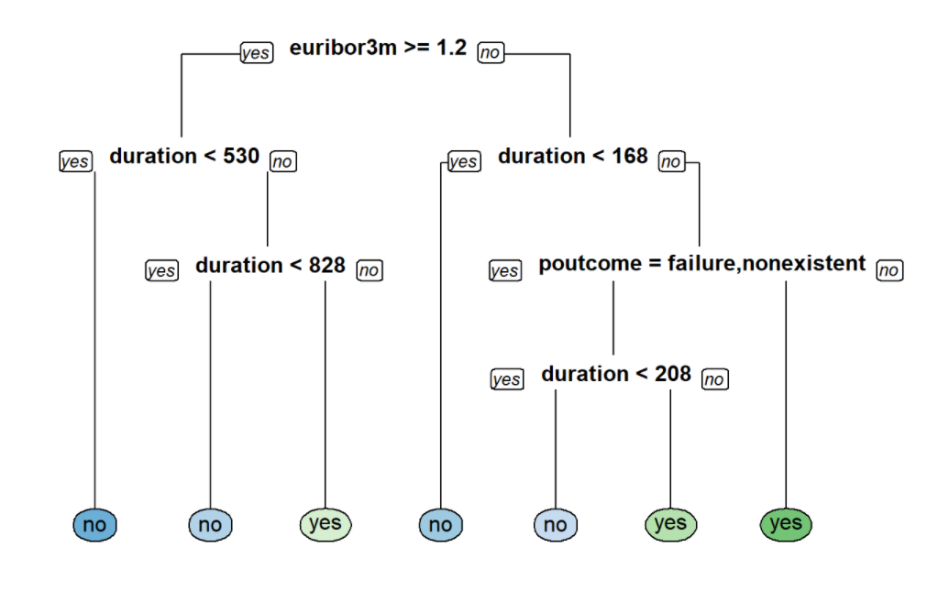
Decision Tree Model
Pros: Easy to visually interpret
Cons: Prone to overfitting, high variance

Slide 8
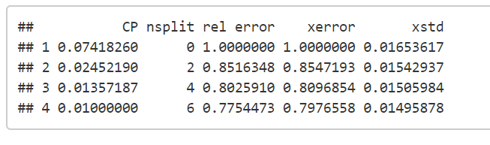
Tuning the Decision Tree Model
Hyperparameters to be tuned
cp (complexity parameter, default=0.1)
Minsplit (minimum number of data points required to attempt a split, default=20)
maxdepth (depth of a decision tree, default=30)
Cp was tuned by visually inspecting cp table

Slide 9
Tuning the Decision Tree Model
minsplit and maxdepth were tuned using a grid search.
minsplit range: 1-20, increments of 1
maxdepth range: 1-30, increments of 1
600 possibilities in total
Compared AUC for each model
Summary of results
Ideal Parameters
Minsplit: 20 (default)
Maxdepth: 3
AUC | 0.5 | 0.676 | 0.7495 | 0.7576
Total | 20 | 20 | 540 | 20

Slide 10
Random Forest Model
Pros: Reduces variance without increasing error and decorrelates trees
Cons: Loses visual interpretability

Slide 11
Tuning the Random Forest Model
Hyperparameters:
mtry (number of variables to sample at each split, default=4 for this data set)
nodesize (controls complexity, default=1)
sampsize (controls variability and randomness, default=63.2% of observations)
mtry, nodesize, sampsize were tuned using a grid search against the validation set
mtry range: 2-8, increments of 2
nodesize range: 2-8, increments of 2
sampsize range: 70 or 80% of the observations
32 possibilities in total

Slide 12
Tuning the Random Forest Model
Used minimum Out-of-Bag (OOB) error to select model
Ideal Parameters
mtry: 8
nodesize: 8
Sampsize: 70% of observations

Slide 13
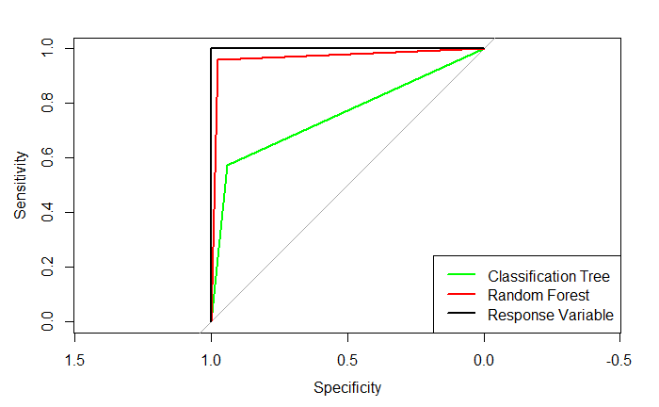
Performance
Model | Accuracy | AUC
Decision Tree (Default) | 0.91 | 0.73
Decision Tree (Optimized) | 0.90 | 0.74
Random Forest (Default) | 0.91 | 0.74
Random Forest (Optimized) | 0.97 | 0.90
ROC Plot for Models after Optimization
Random Forest model performed better than Decision Tree in accuracy and AUC.
ROC Curve for Random Forest is also closest to the ideal curve.
Conclusion: Use Random Forest with hyperparameter optimization

Slide 14
Thank you!

